Slide 1
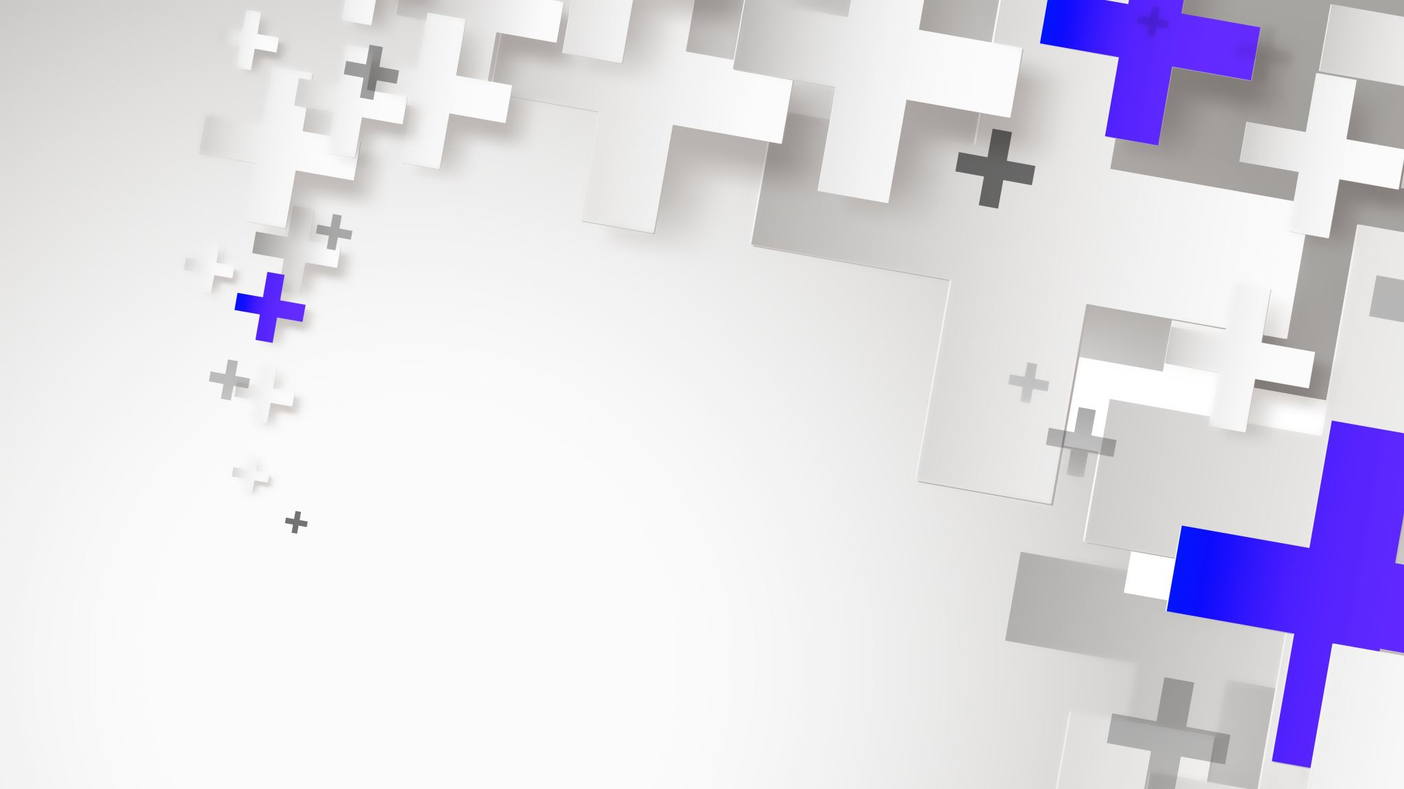
DATA MINING HW-1
Implemented DB-Scan mentioned in the book.
I used python for find the result.

Slide 2
DB-Scan
The DBSCAN algorithm performs clustering by grouping areas with more objects than the threshold value, calculating the distance of objects from their neighbors and giving a specific instruction task.
The DBSCAN algorithm is based on revealing the neighborhoods of data points with each other in two or multi-dimensional space. Database is mostly used in the analysis of spatial data because it deals with a spatial perspective.

Slide 3
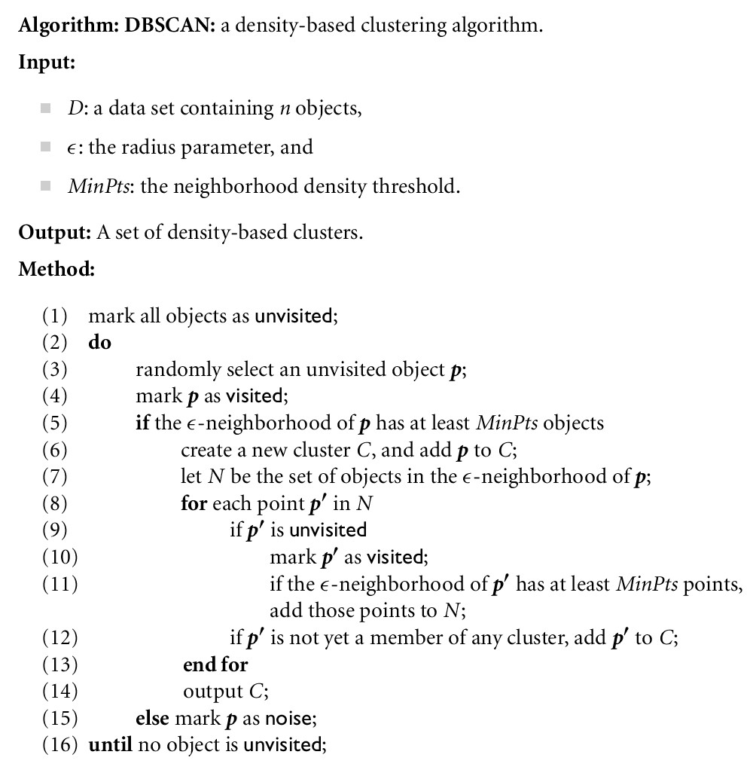

Slide 4
TESTS

Slide 5
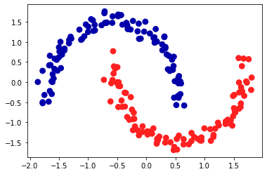
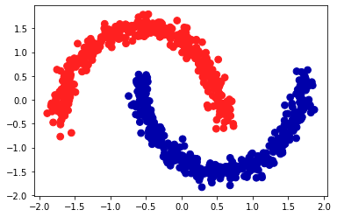
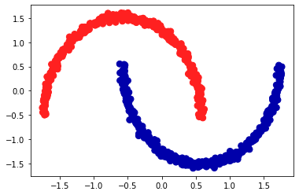
Take data set for make_moons
Make two interleaving half circles
A simple toy dataset to visualize clustering and classification algorithms.
Parameters
n_samples : int, optional (default=100)
The total number of points generated.
shuffle : bool, optional (default=True)
Whether to shuffle the samples.
noise : double or None (default=None)
Standard deviation of Gaussian noise added to the data.
Returns
X : array of shape [n_samples, 2]
The generated samples.
y : array of shape [n_samples]
The integer labels (0 or 1) for class membership of each sample.

Slide 6
make_moons(n_samples=750, noise=0.02, random_state=0)

Slide 7
make_moons(n_samples=200, noise=0.06, random_state=42)

Slide 8
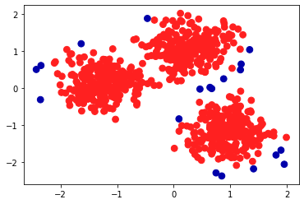
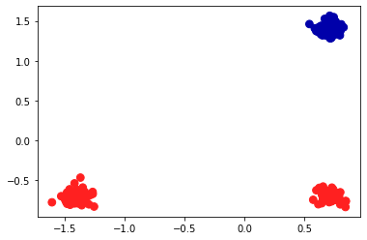
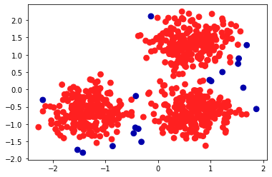
Take data set for make_blobs
Generate isotropic Gaussian blobs for clustering.
Parameters
n_samples : int, optional (default=100)
The total number of points equally divided among clusters.
n_features : int, optional (default=2)
The number of features for each sample.
centers : int or array of shape [n_centers, n_features], optional
(default=3) The number of centers to generate, or the fixed center locations.
cluster_std: float or sequence of floats, optional (default=1.0)
The standard deviation of the clusters. shuffle : boolean, optional (default=True)
random_state : int, RandomState instance or None, optional
Returns
X : array of shape [n_samples, n_features]
The generated samples.
y : array of shape [n_samples]
The integer labels for cluster membership of each sample.

Slide 9
centers = [[1, 1], [-1, -1], [1, -1]] make_blobs(n_samples=750, centers=centers, cluster_std=0.4, random_state=0)

Slide 10
centers = [[1, 1], [-1, -1], [1, -1]] make_blobs(n_samples=200, centers=centers, cluster_std=0.06, random_state=42)

Slide 11
make_blobs(n_samples=750, cluster_std=0.6, random_state=0)

Slide 12
RESOURCES
Turgay Tugay BİLGİN, Yılmaz ÇAMURCU ‘Applied Comparison of DBSCAN, OPTICS and K-Means Clustering Algorithms’, Journal of Polytechnic Vol: 8 No: 2 pp. 139-145, 2005
Data Mining Concepts and Techniques, Jiawei Han and Micheline Kamber, Third Edition, 2011
https://www.youtube.com/watch?v=6BcJxBE5J5I
https://scikit-learn.org/stable/auto_examples/cluster/plot_cluster_comparison.html

